Slide 1

LendingClub.com
An analysis to Predicting whether a user pays back loan in full or not
Submitted by
Bimal P Baby

Slide 2
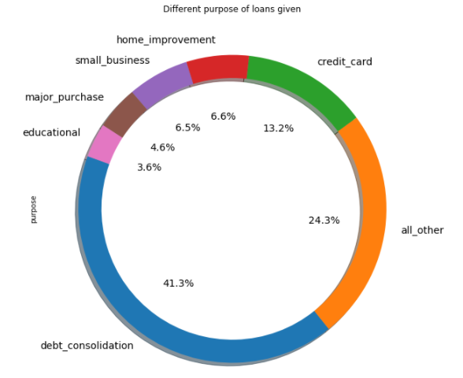
Different sectors in which loan given
There are 7 sectors.
In which debit consolidation has 41.3%, others make 24.3%, Credit card 13.2%

Slide 3
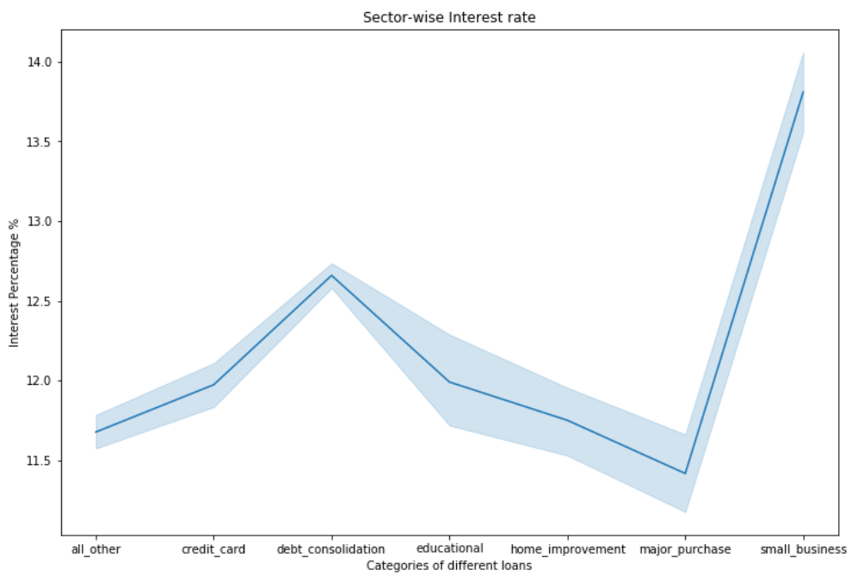
Sector-wise interest rate
Interest rate is high for small business +13.5% to 14%
But It is less for major purchases approximately +10% to 12%

Slide 4
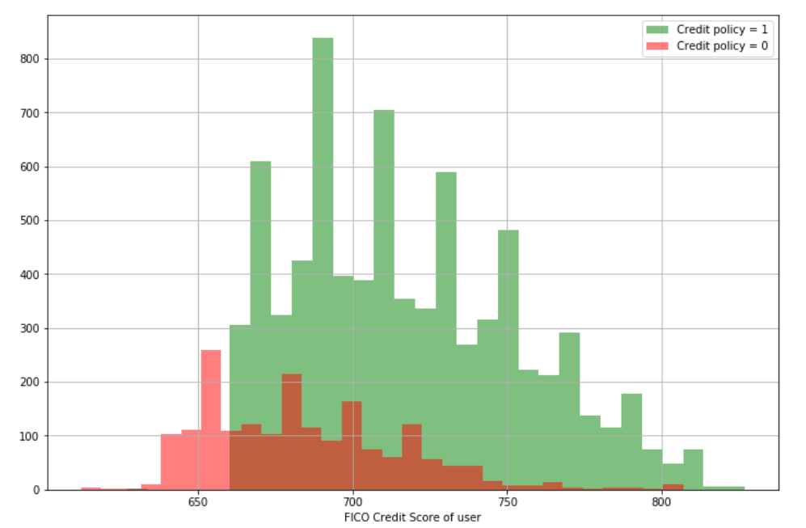
FICO credit score vs Loan credited
FICO is the rating of the loan applicant
As the Fico rate is high the chance for loan sanctioning increases
FICO Rate below 670 show that the loan is rejected

Slide 5
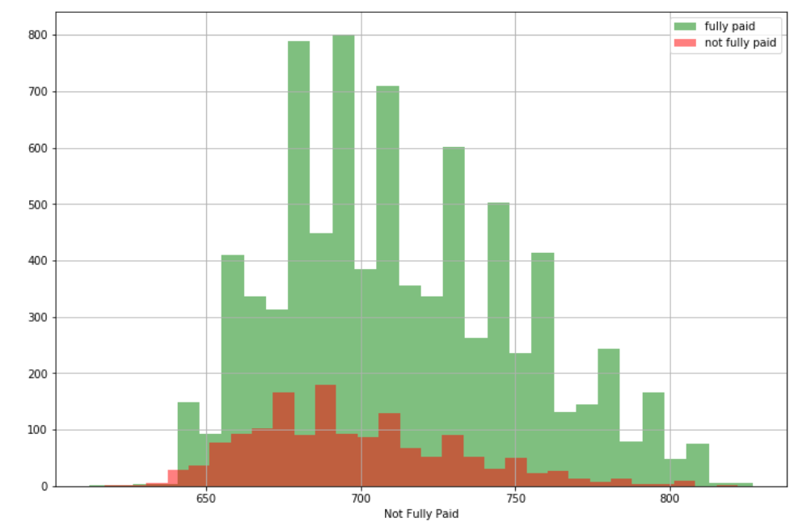
Loans repaid vs FICO score
As the FICO score increases the loan repaid increases
Lower the FICO score higher the chance for loan not repaid

Slide 6
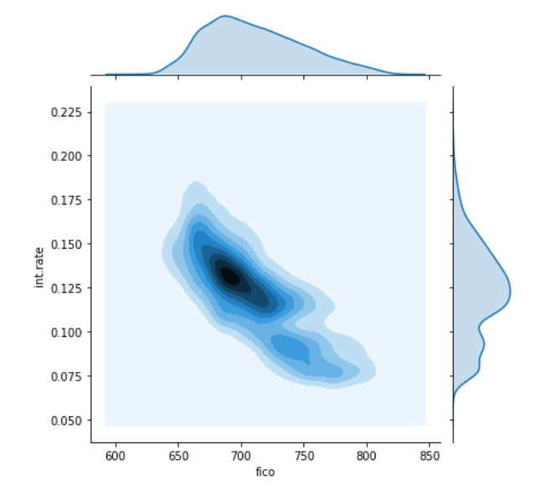
FICO vs Interest rate
The density plot shows the Trend of Interest rate and FICO score for the loans sanctioned
The density of loan given is high from 12% to 15% and
FICO score is 680 to 725

Slide 7
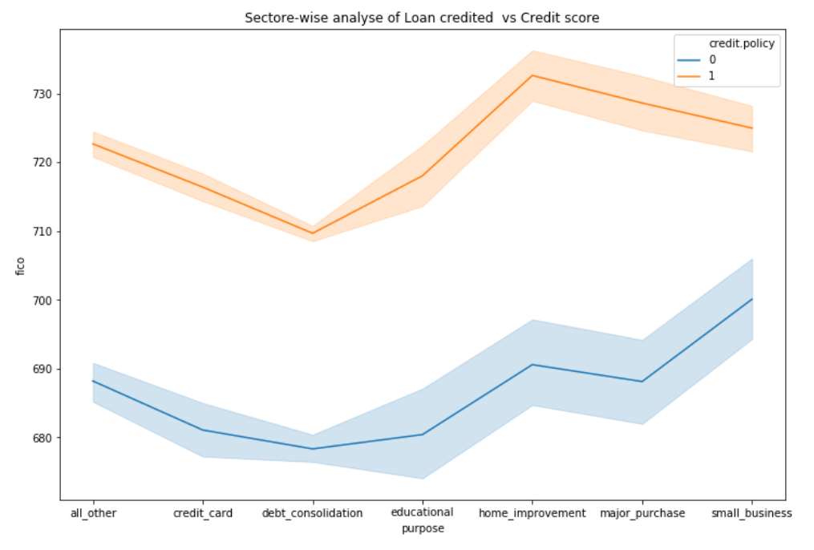
Sector wise analysis of Loan Credited vs Credit score
It shows that Loans are credited mostly for home improvement
And least for Educational purposes

Slide 8
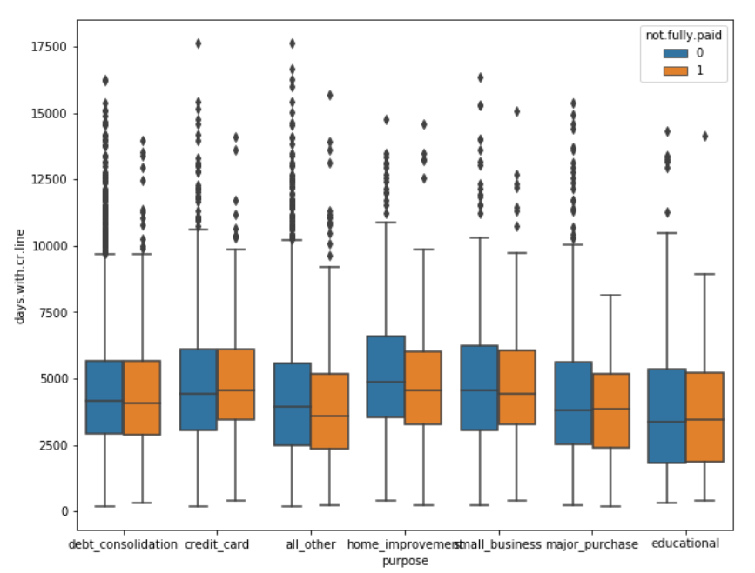
Days of Credit vs Sector
Higher days of Credit is for Credit card and Home improvement
In which Home loans are repaid most

Slide 9
Results from Accuracy analysis
Hence we can conclude that,
Logistic regression : 83% accuracy
Decision Tree base model : 72% accuracy
RandomForestClassifier : 83%
GridsearchCV and RandomizedsearchCV could give a model of 83% accuracy

